Slide 1




Hexaware CODE&RISE PROGRAM
Captain's Crew
Crew up, code on

Slide 2
Team Details
Team Name - Captain's Crew
Application Name – Automated Question Builder
Team Members
Email ID
G K HARIHARAN
hariharanpk725@gmail.com
NANDHA GOPAL T
nandhathanikai@gmail.com
SRIKANTH V
srikanth047v@gmail.com
AFZAL HAMEETH N
afsalhameeth271103@gmail.com

Slide 3

Impact/Potential Value of the Application
-> Time Saving:
This saves time since question generation happens through automating that eliminates handiwork involved with it.
-> Consistency:
Questions are stable and precise within themselves.
-> Better Assessment:
More pertinent and superior quality questions are
guaranteed.
-> Data Insights:
A priceless analysis of instructed performance numbers.
-> Cost-effective:
There’s less money spent in manually composing queries.

Slide 4
The Solution Proposed by your Team
Solution Highlight:
This is an AI-powered automated question builder that lets you generate customizable questions, adjust their difficulty, and get real-time suggestions. It supports different question formats, offers both text and document input, and gives instant feedback. Plus, it integrates smoothly with LMS platforms, making it easy to export and collaborate, really streamlining the whole question creation process for both educational and professional use.
- AI Generation
- Customizable Types
- Difficulty Adjustment
- Real-time Feedback - Question Regeneration - Multimodal Input - LMS Integration - Collaborative Creation
:
Key Features / Approach:

Slide 5




Technologies Used
Front End:
Back End:
Database:
Other Tools:
AWS
Google cloud
Docker
Git
Figma

Slide 6
Gen AI Tool Utilization
Text Generation Models:
OpenAI's GPT-3/4:Use for generating contextually relevant questions based on input text or datasets. It can generate various question types, such as multiple-choice, fill-in-the-blank, or open-ended questions.
Question Answering Models:
OpenAI Codex (for coding-related questions): Generate coding questions, explain code snippets, or create questions based on code output.
Contextual and Adaptive Learning:
Context-Aware Models: Utilize AI models that adapt to the user's learning level, prior interactions, and specific subject matter to generate personalized questions.
Dynamic Difficulty Adjustment: Use AI to adjust the complexity of questions in real-time based on the user's performance and interaction history.
Analytics and Insights:
AI-Driven Analytics: Implement AI tools to analyze question performance, user engagement, and learning outcomes. This data can be used to refine question generation and improve overall application effectiveness

Slide 7
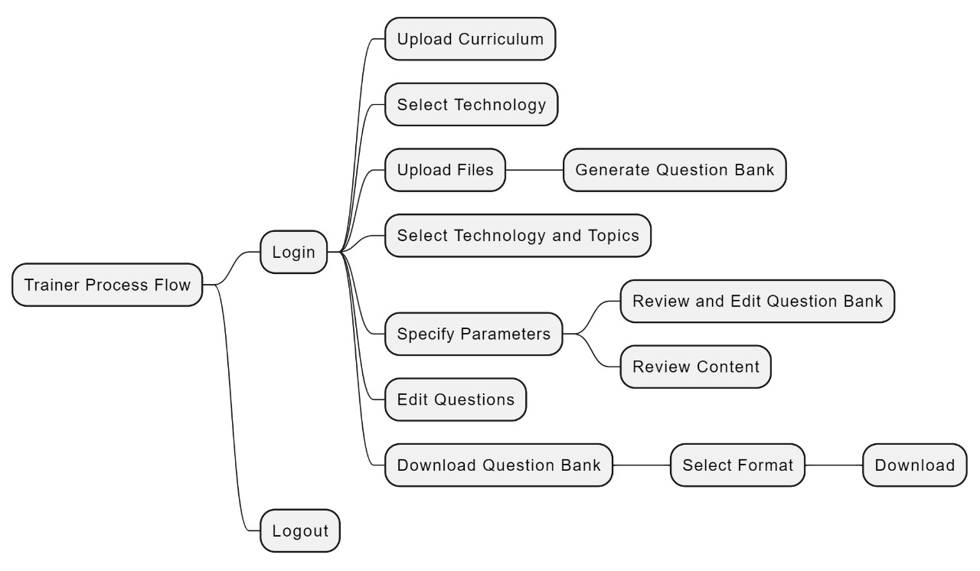
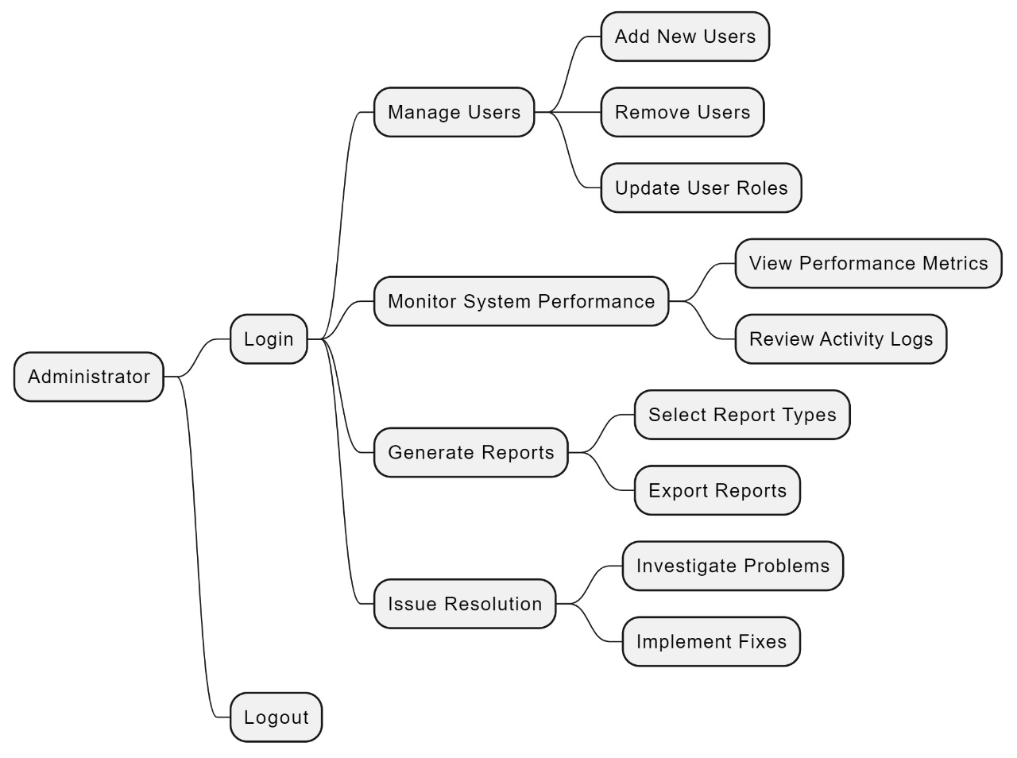
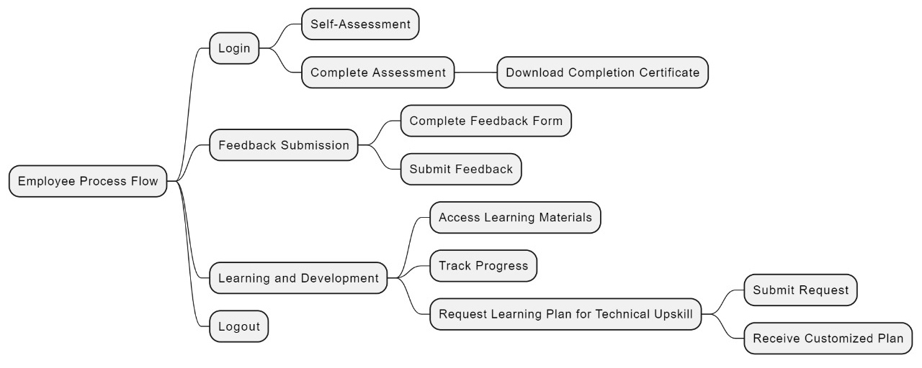
System Architecture, Functionalities and Design Diagram

Slide 8
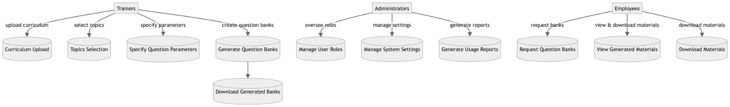
How it works Functional Architecture

Slide 9
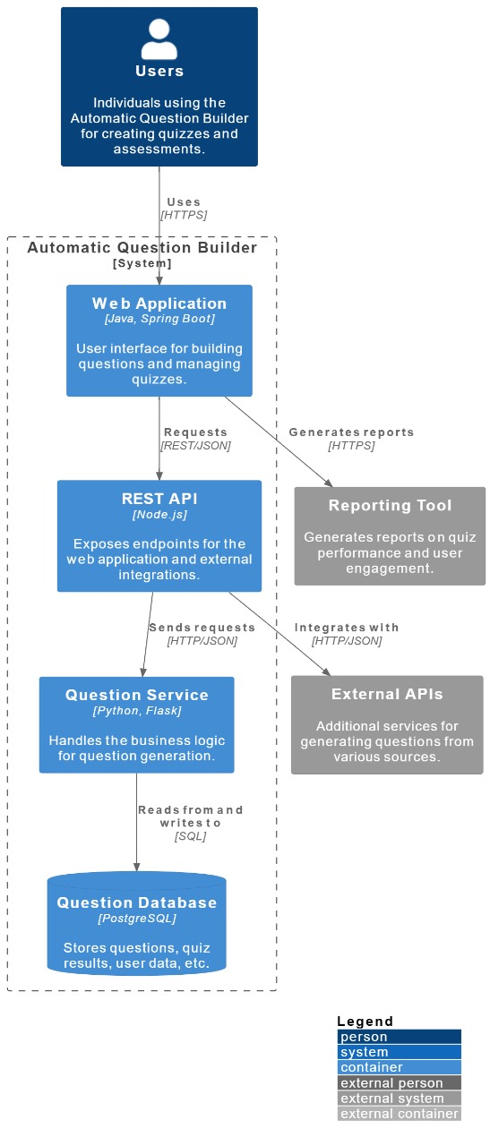
How It Works Technical Architecture

Slide 10
Innovation and Creativity
Scalability:
Grow with You: It effortlessly grows with your growing hackathon to provide a seamless experience for every participant.
Flexible Infrastructure:
It is designed to adapt, scaling up or down based on your needs so you are always prepared for what is coming next.
Performance:
Speed That Feels Instant: Questions generated fast mean responsive and assured continuity in flow for participants.
Reliable and Ready:
The system is built for peak times, providing consistent performance from the start to the end of your event.
Trust Through Vigilance:
Robust security with continuous monitoring keeps your data secure against any kind of threat. Robust security with continuous monitoring keeps your data secure against any kind of threat.

Slide 11
Scalability, Performance and Security
Scalability, Performance and Security
Scalability:
It effortlessly grows with your growing hackathon to provide a seamless experience for every participant. Flexible Infrastructure: It is designed to adapt, scaling up or down based on your needs so you are always prepared for what is coming next.
Performance:
Questions generated fast mean responsive and assured continuity in flow for participants. Reliable and Ready: The system is built for peak times, providing consistent performance from the start to the end of your event.
Security:
Your Data, Safeguarded: Your questions and participant information are safeguarded with end-to-end encryption for peace of mind.
Trust Through Vigilance: Robust security with continuous monitoring keeps your data secure against any kind of threat.

Slide 12
Best practices and industry standards followed
Content Accuracy:
Ensure questions are fact-checked and aligned with the learning objectives.
Difficulty Leveling:
Implement algorithms that adapt question difficulty based on user performance.
Question Variety:
Include multiple question types (e.g., MCQs, fill-in-the-blanks, and short answer).
Accessibility:
Design questions that are accessible to all users, including those with disabilities.
Data Security:
Secure user data with encryption and comply with data protection regulations.
Scalability:
Ensure the system can handle a large volume of users and questions efficiently.

Slide 13
User Experience
1. Intuitive Interface:
-Simple, easy-to-navigate design for all users.
2. Personalization:
-Tailored questions based on user preferences and performance.
3. Instant Feedback:
-Clear, immediate feedback to boost engagement.
4. Mobile Compatibility:
- Seamless functionality across all devices.
5. Accessibility:
-Features like text-to-speech and adjustable font sizes for inclusivity.

Slide 14
Console Output Details
Figma Prototype Link: https://rb.gy/q22g9m
GitHub Repository Link: https://github.com/srikanth230/Captain-s-Crew_Question-Builder

Slide 15
Phase 1 - Judging Criteria
Solution Approach
Usage of Gen AI tools
Solution Feasibility
Technical Approach/Architecture Design
Innovation and Creativity
User Experience
Documentation and Presentation
Console Output

Slide 16
Thank You

